Slide 1
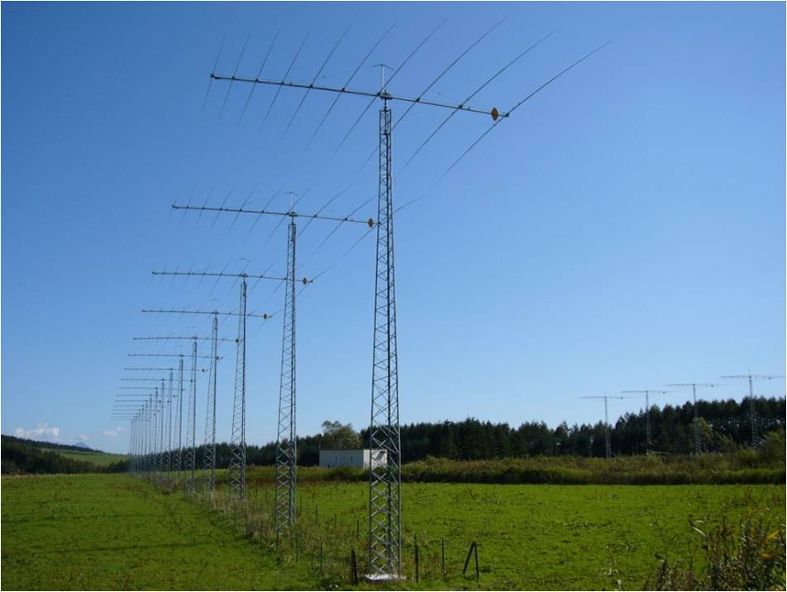
Study of mid-latitude ionospheric convection
during super quiet, quiet and disturbed period
with the SuperDARN Hokkaido radar
Yun Zou and Nozomu Nishitani
（STEL, Nagoya University）
2011 SuperDARN Workshop
June 2, 2011

Slide 2
Reasons of generation of the mid-latitude ionosphere convection
Background(1/6)
Influence from high latitude convection (the penetration electric field)
Formation of convection by tide (which dominate at low latitude)
Disturbance dynamo(which provides very large influence at mid-latitude)
Our study of mid-latitude ionosphere convection will forces on Disturbance dynamo effects.

Slide 3
Observation result using Millstone Hill radar by Gonzales et al. [1978] and Richmond et al. [1980]
Background(2/6)
And the empirical model
Geomagnetic latitude:57
East
Especially quiet time
Less quiet time
West
Kelley and Rodney, 1989

Slide 4
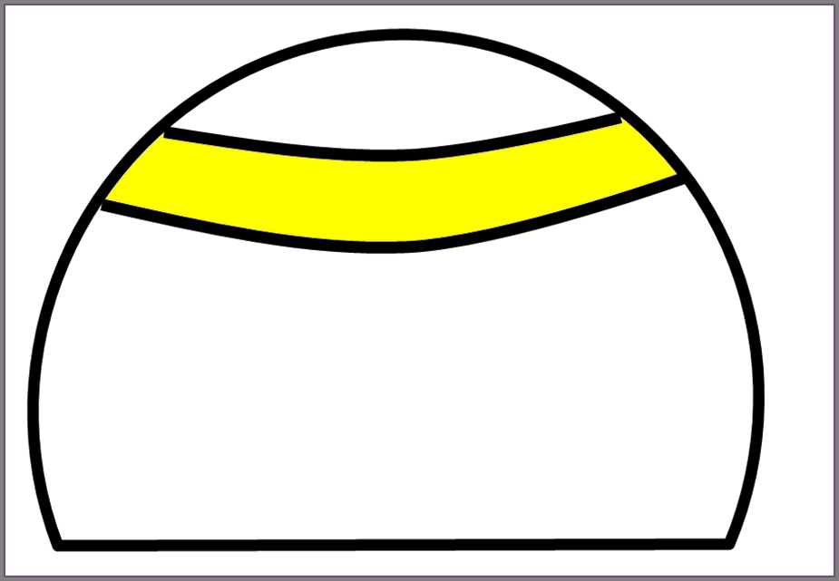
The Mechanism of disturbance dynamo
Background(3/6)
Coriolis force change southward neutral wind to westward
Joule heating
UxB electric field (Pedersen current)
Auroral electrojet
ion drag force
Charge appears due to the conductivity gradient
－
－
westward ExB drift in the mid-latitude
＋
＋
Evening
Night side
morning
Blanc and Richmond, 1980
Notes:
conductivity gradient.

Slide 5
Background(4/6)
The result by the simulation of westward drift of F-region ionospheric plasma at mid-latitude develops with the growing of the storm.
In mid-latitude of Case I (night side), the speed of the westward plasma drift increases as the geomagnetic disturbance develops.
East
West
Blanc and Richmond, 1980

Slide 6
Background(5/6)
Ionospheric disturbance dynamos lasted up to
50 hours in the midlatitude region at night
East
West
Observation point ： Bundoora (145.1°E, 37.7°S geographic, 49°S magnetic), Australia
Observation equipment : Digisonde drift measurements
Statistical methods : Superposed Epoch Analysis (SEA)
Database : 5‐year (1999 to 2003)
Numbers of Dst-defined storms : 262
Kumar et al., 2010

Slide 7
Overview of disturbance dynamo at mid-latitude from Previous studies
Background(6/6)
Dominates at mid-latitude
Provides strong influence of westward flow
The influence becomes larger with the growth of storms
The influence may last for 50 hours
Geomagnetic latitude dependence was not shown by the observation

Slide 8
Purpose of this study
To examine a geomagnetic index Kp and geomagnetic latitude dependence of the mid-latitude ionosphere plasma convection (especially the westward flow on the night side) for each season.
To examine geomagnetic latitude dependence of the chronological influence from the Dst-defined storm.
SuperDARN
Hokkaido
radar
SuperDARN Hokkaido radar
Location : 43.5°N geographic, 36°N magnetic
Observation area : about 40°to 80°N

Slide 9
Method of this study
To study the geomagnetic activity dependence and the geomagnetic latitude dependence of the ionospheric mid-latitude conviction, we fit the vector by calculating the data from beam 1 to 14 obtained by the SuperDARN Hokkaido radar to get the westward and northward component of Doppler velocity. Then we plot the result in the polar map.
To study the geomagnetic latitude dependence of the chronological influence of magnetic storm, we use the Superposed Epoch Analysis (SEA) method by putting the -20h to 60h data of each Dst-defined storm together and fit them at 0h which is the start time of each storm.

Slide 10
Statistical distribution of east-west velocities with several Kp ranges in winter (Nov to Jan) from December, 2006 to January, 2011.
Result(1/2)
West
Kp≦0+ and
Kp<2+ for
previous 50 hrs
Kp≦0+
East
21
3
21
3
0+<Kp≦1+
1+<Kp≦2+
Kp>2+
21
3
21
3
21
3

Slide 11
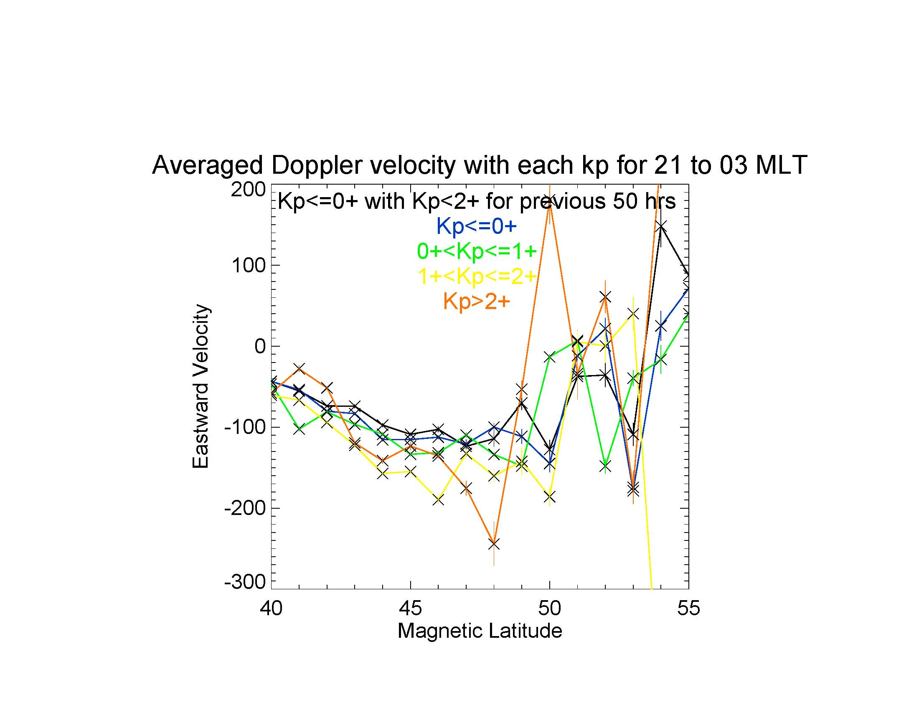
Result(2/2)
East
With increasing Kp index, westward flow becomes more intense in the nightside mid-latitude region.
(m/s)
West

Slide 12
Result of east-west component
Discussion
Comparison with past studies
In contrast to the result of Gonzales et al., night side eastward flow was not observed during deadly quiet periods.
Why?
One important factor of gradient drift instability is most likely to generate ionospheric irregularities.
Gradient drift instability occurs when the electric field is strong enough, so that the ionospheric echoes are observed preferably when the electric field is strong(Fukumoto et al., 2000).
Westward flow is observed preferably when the electric field is strong.
A Pedersen ion drift (to the right) leads to charge separation and the development of polarization electric fields, Ep. The sense of Ep drives Ep×B motion that further enhances the original plasma perturbation.
TSUNODA, 1988

Slide 13
Result of chronological influence of magnetic storm(1/3)
West
In this study, the biggest storm happened on December 14, 2006. The value of Dst index felled down to -146nT.
East
2006/12/15
2006/12/16
2006/12/17

Slide 14
Result of chronological influence of magnetic storm(2/3)
Storm Time(t) | All Storms | Short-Duration | Medium-Duration | Long-Duration
-7h≦t≦-1h | Dst>-30nT*1 | Dst>-30nT*1 | Dst>-30nT*1 | Dst>-30nT*1
0h≦t≦6h | Dst≦-30nT*2 | Dst≦-30nT*2 | Dst≦-30nT*2 | Dst≦-30nT*2
7h≦t≦13h | ― | Dst>-60*3 | Dst≦-60*4 | Dst≦-60*4
14h≦t≦20h | ― | ― | Dst>-60*3 | Dst≦-60*4
Number of Storms | 48 | 43 | 4 | 1
*1 : 1 or less in seven hours satisfy the stated condition
*2 : 3 or less in seven hours satisfy the stated condition
*3 : All 7 consecutive hours satisfy the stated condition
*4 : At lest 1 hour satisfy the stated condition
48 storms defined by the hourly Dst index which satisfy the criteria, from December, 2006 to April, 2011.
We use the criteria adopted by Kumar et al., 2010.

Slide 15
Result of chronological influence of magnetic storm(3/3)
Medium- and long-duration storms
for westward flow of SEA response
We can’t find outstanding influence of storm from the result of all storms. This may be because relative number of short-duration storms is large.
West
All storms
for westward flow of SEA response
East
From the result of 5 events of medium- and long-duration storms we can confirm that the influence of storm lasts up to 20 hrs after onset between 43 and 47 degrees.

Slide 16
Summary(1/2)
The statistical analysis shows the geomagnetic index Kp and geomagnetic latitude dependence of the mid-latitude ionospheric plasma convection from the observation of SuperDARN Hokkaido radar in all seasons. The mid-latitude night side westward flow has Kp dependence intensified for disturbed periods in all seasons.
But, even if the Kp was 0 to 0+ and the influence from the previous 50 hrs has been take out, the mid-latitude night side flow was westward, which is inconsistent with Gonzalez et al.’s result. This is considered to be because the westward flow was observed by the presence of ionospheric irregularity preferably when the convection electric field is strong, leading to the growth of gradient drift instability.

Slide 17
Summary(2/2)
The Superposed Epoch Analysis (SEA) result shows a latitude dependence of the influence from the storm. From the result of 5 events of medium- and long-duration storms we can confirm that the influence of storm lasts up to 20 hrs after onset at several latitude of mid-latitude.
In mid-latitude equatorward flow in winter and poleward flow in summer were observed on the night side. This is corresponding to the result of Mori(graduate research, 2009) and Richmond et al., 1980.

Slide 18
Future work
Further study of geomagnetic activity dependence (solar activity level and sub-storm dependence) of the mid-latitude ionospheric plasma convection is necessary.
More events of each duration storms need to be studied to extend the detailed result of data analysis.
Other possible factors to affect mid-latitude convection besides the disturbance dynamo should be investigated.

Slide 19
Thank you for listening.

Slide 22
Statistical distribution of east-west velocities with several Kp ranges in winter (Nov to Jan) from December, 2006 to April, 2011.
Result
West
Kp≦0+ and
Kp<2+ for 50 hrs
Kp≦0+
East
0+<Kp≦1+
1+<Kp≦2+
Kp>2+

Slide 23
Statistical distribution of east-west velocities with several Kp ranges in spring (Feb to Apr) from December, 2006 to April, 2011.
West
Kp<0+ and Kp<2+ for 50 hrs
Kp≦0+
East
0+<Kp≦1+
1+<Kp≦2+
Kp>2+

Slide 24
Statistical distribution of east-west velocities with several Kp ranges in summer (May to Jul) from December, 2006 to April, 2011.
West
Kp<0+ and Kp<2+ for 50 hrs
Kp≦0+
East
0+<Kp≦1+
1+<Kp≦2+
Kp>2+

Slide 25
Statistical distribution of east-west velocities with several Kp ranges in autumn (Aug to Oct) from December, 2006 to April, 2011.
West
Kp<0+ and Kp<2+ for 50 hrs
Kp≦0+
East
0+<Kp≦1+
1+<Kp≦2+
Kp>2+

Slide 26
Statistical distribution of north-south velocities in Summer (May to July) and Winter (Nov to Jan) from December, 2006 to April, 2011.
Result of north-south component
Summer
Winter
South
North
All Kp
Notes:
詳しく見ろ

Slide 27
All storms
for westward flow of SEA response

Slide 28
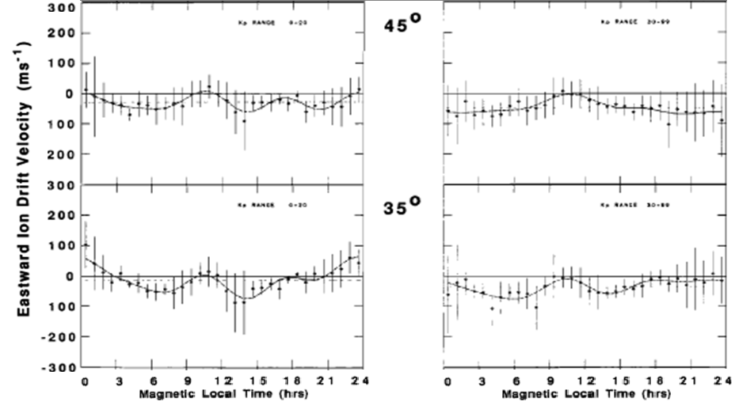
The observation by DE2 satellite of the east-west component of ion drift in mid-latitude
1． Background
With the growing of geomagnetic activity the drift for west becomes dominate near magnetic latitude 50 degrees on the night side.
In lower latitude the effect of tide is predominant .
Quiet time（Kp≦2）
Disturbed time（ Kp≧3）
East
West
East
West
Heelis and Coley, 1992

Slide 29
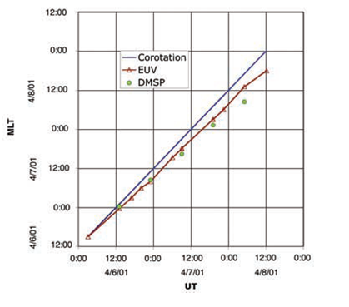
In plasmasphere which relates to the ionosphere also has a drift for west in mid-latitude which calls co-rotation lag.
1． Background
Plasmasphere distribution caught by EUV camera equipped on IMAGE satellite on April 6-8, 2001
The forecast of the position of the notch observed by the DMSP ion drift meter that appears delaying because of the earth`s rotation.
Burch and Goldstein, 2004

Slide 30
The observation of the Wallops SuperDARN radar which is located at magnetic latitude 49.4 degrees.
1． Background
When geomagnetic activity is comparatively quiet（Kp≦３）。
Ionosphere average convection pattern that is calculated form the observation data from June, 2005 to August, 2006.
In mid-latitude, the influence of the high latitude convection is far weaker, and movement for the west driven by the Disturbance dynamo action is more predominant.
Baker et al., 2007

Slide 31
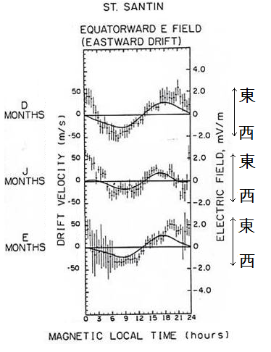
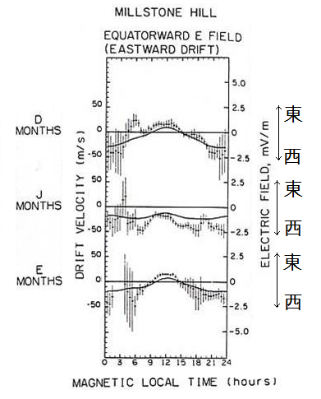
Quiet time（Kp≦３）average drift velocity observation and model result
1． Background
IS radar
East
West
East
West
East
West
East
West
East
West
East
West
（G:44.1 M:40)
（G:42.6, M:57)
G： geography latitude
M：geomagnetic latitude
Richmond, 1980

Slide 32
1． Background
Limit of the current observation
The ionosphere convection characteristic was chiefly observed with the IS radar like the Millstone Hill radar in the past.
It is possible only to observe an overhead ionosphere with IS radar which called ‘one point observation’, and give an observation result of one dimension.
It is more effective though two dimensions can be observed by using the SuperDARN radar and the low-altitude satellite, to examine ionospheric characteristics. Also because the low-altitude satellite give an observation while turning round the earth (It takes about 1 hour and 40 minutes around), a continuous observation may not be done.
Most of the SuperDARN radar was set up in the high latitude region, and there was no HF radar in the mid-latitude until SuperDARN Wallops radar and SuperDARN Hokkaido radar in recent years. Because the mid-latitude region from 40 to 50 degrees is not covered in the observation of the SuperDARN Wallops radar which sets up in a magnetic latitude 49.4 degrees, accurate convection pattern of this region cannot be understood.
The observation data of the SuperDARN Wallops radar is a incomplete because of the cause of the breakdown etc.

Slide 33
About the observation result of the SuperDARN Hokkaido radar
4．Result
From Mori(graduate research, 2009), there is a seasonality variation of the plasma flow from a magnetic latitude 40 degrees to about 60 degrees. Especially, flow for the northwest was able to be observed on the night side in winter.
--However, it is necessary to remove the influence of the ground scatter echo in other seasons without winter.
It is difficult to remove the ground scatter echo from the data of Doppler velocity observed by SuperDARN Hokkaido radar perfectly.
--However, because of the ground scatter echo and the ionosphere scatter echo divide clearly at least in winter and the ground scatter is few on the night side of winter, it is dependable.

Slide 34
Discussion ②
5．Discussion
East
West
East
West
East
West
Comparison with past research
Even the geography latitude and the geomagnetic latitude were almost the same with the St. Santin radar, the flow for the east at pre-midnight haven`t been observed.
（G:42.6, M:57)

Slide 35
Summary ①
6． Summary
It was clarified that there was geomagnetism index Kp dependency of the mid-latitude ionosphere plasma convection from the observation of SuperDARN Hokkaido radar at each season.
Especially, it was clarified that the flow for the west on the night side in mid-latitude at each season has a geomagnetism index Kp dependency.
--However, when geomagnetism index Kp indicated the value below 0+, the flow for the west on the night side in mid-latitude was also be confirmed. This is thought to be the observation of the flow for west by priority when the convection electric field is strong because the gradient drift instability.

Slide 36
Summary ②
6． Summary
In mid-latitude a flow for the equator in winter and a flow for the pole in summer was observed on the night side. This is corresponding to the result of Mori(graduate research, 2009) and Richmond et al., 1980.
The convection cell in high latitude was observed to develop down to lower latitude along with the increasing of the geomagnetism index Kp.

